Slide 1
Integrating genAI Into Learning
GCSN AI PLD Module 3

Slide 2
Acknowledgements
This PLD module was last updated January 2025.
This is part three in a series of three, short genAI PLD modules for educators. It should take approximately 45-60 minutes to complete, depending on how long you choose to dedicate to practical activities.
Artificial intelligence will increasingly impact teaching and learning. This is a fast-moving space, and keep in mind that our understandings of the best practice and practical applications of genAI will change over time.
We welcome feedback and questions regarding this PLD module, and we would like to hear from educators using AI technology successfully in their practice. Contact Gabrielle Wall, GCSN General Manager, at gabrielle.wall@gcsn.school.nz

Slide 3
Professional Learning Module
This Professional Learning & Development (PLD) module can be taken alone (self-guided) or be presented to a group.
It should take 45-60 minutes.
Where necessary, there are speaker notes at the bottom of the presentation.
Take your time and consider the discussion questions and practical activities.
Some questions you can take away and ask peers and colleagues!

Slide 4
Module 3: Integrating genAI Into Learning
The third module addresses ways that educators can introduce genAI into learning activities in meaningful ways that enhance learning, rather than replace it.
By the end of this session, Kaiako/Teachers will:
Understand how genAI can be an assistive tool in teaching and learning
Know how to use genAI for assisting in lesson planning
Have several ideas for integrating genAI into lesson plans

Slide 5
Can genAI Be Used For Learning?
Generative AI (genAI) tools such as ChatGPT can create outputs based on the prompts given to them. This includes text, pictures, music, videos etc.
It is trained on huge amounts of data that allow it to complete complex tasks.
It is not fool-proof, it does not have a consciousness and does not have human judgment. It is subject to mistakes and the biases that exist in the data it is trained on.
genAI tools can be used for learning purposes and may have positive impacts on student engagement and teacher engagement.

Slide 6
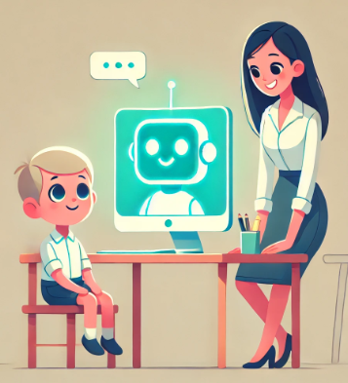
Why Does AI Matter in Education
The technology of genAI such as Large Language Models (LLMs) are advancing rapidly. This includes tools like ChatGPT.
As technology advances, it will likely change the ways that people work and learn, and industries will be changed as they integration automation.
This is also true of education – AI will become increasingly prevalent.
By not preparing students to use genAI in appropriate and effective ways, schools and kura risk not preparing them for technological advancements that require critical thinking and adaptability.
Schools/kura should focus on helping students use genAI effectively, responsibly, and ethically, so they can use it for the future as a tool.

Slide 7
What Could genAI Do for Learners?
Ākonga may benefit in a number of ways by learning to effectively use genAI. We will break these down one at a time and include examples for teachers.
There are separate downloadable documents for example learning activities that may be edited for younger audiences.
The last presentation focused on keeping ākonga safe while using genAI. This presentation focuses more on practical activities using genAI to encourage deeper learning.
Note for brevity that some screenshots are cut off to not include the full ChatGPT response.

Slide 8
#1: genAI As a Teaching Assistant
genAI may be used as a personal assistant tool for kaiako.
This includes things like:
lesson planning
resource creation
creating quizzes and assessments
summarising complex information
providing feedback on writing
It is important that genAI is used as an assistive tool, rather than as a replacement to cut corners.

Slide 9
Using genAI As a Teaching Assistant
genAI can assist in administrative tasks and teaching activities.
Some specific examples include:
Creating assessment rubrics
Tracking attendance and other trends
Providing summaries of learning progress based on data
Making recommendations on areas of development
Creating a lesson plan around specific topics or curriculum areas
Creating lessons and materials that address specific curriculum requirements
Creating unique problems and quizzes with scoring sheets
Notes:
Have you tried using tools like ChatGPT for any of the following? Just remember to be very careful about the information you share with genAI, so as not to provide it with private information such as student/school names etc.

Slide 10
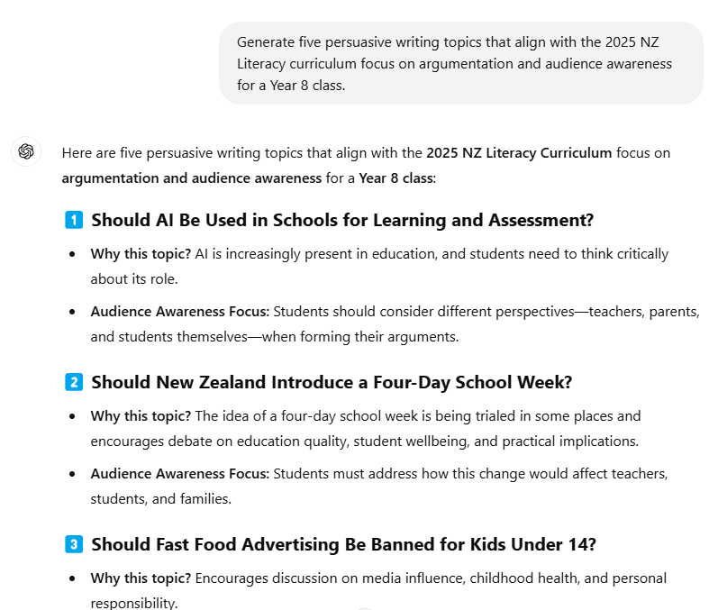
Example #1
Imagine you are a Year 8 Kaiako preparing a lesson on persuasive writing.
genAI helps generate prompts that align with the NZ literacy focus on persuasive techniques and real-world issues.

Slide 11
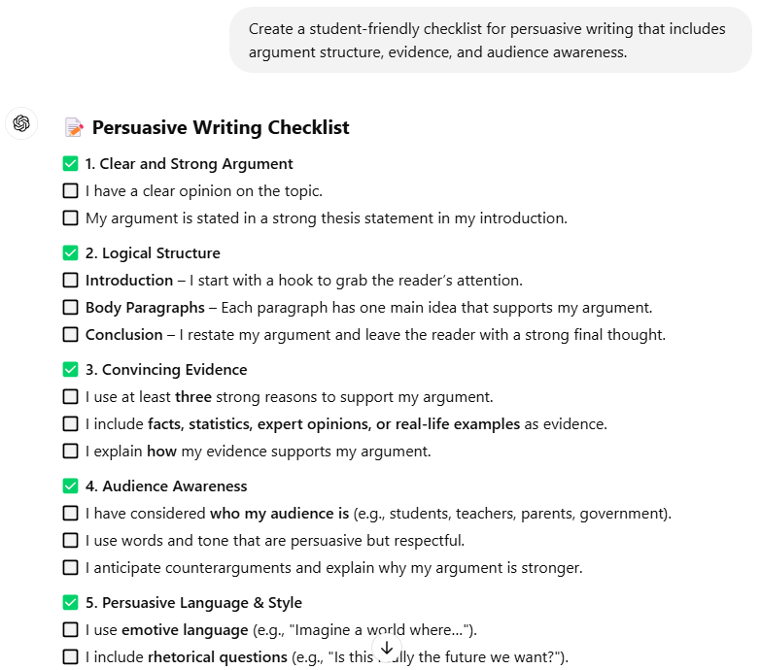
Example #1
genAI helps create a student-friendly checklist for persuasive writing.

Slide 12
Key Takeaways
genAI can support teachers but it cannot replace human interaction and direct instruction.
While genAI can help in lesson planning, its outputs must still be critically evaluated and revised.
genAI can enhance differentiation and kaiako can use it to make differentiated lesson plans quickly to meet various ākonga needs.
Use genAI as an assistive tool rather than teaching replacement. Consider what information you provide and don’t disclose personal information (such as names).
Consider areas of the curriculum that often take the most administrative work? How could genAI help you shorten this process?

Slide 13
#2: genAI for Personalised Learning
genAI can adjust lesson plans and materials based on mixed student abilities.
It can also provide support for diverse learning needs, including those with learning disabilities.
It can focus on different kinds of learning preferences, such as by supplementing written materials with visual ones such as mind maps, diagrams etc.
Examples include differentiated texts to target multiple reading levels, differentiated problems for those at different conceptual levels, and tailored revision activities to target learning gaps.

Slide 14
Using genAI for Personalised Learning
It is difficult to make bespoke lesson plans for classes with ākonga at different learning levels.
This is particularly true as curriculum expectations change.
genAI can help match the lessons and materials to the curriculum, making adjustments for students that need extra help or who are working above expectations.
There is also the potential for genAI to make lessons tailored to student interest areas which may help target those struggling to engage.
REMEMBER not to provide genAI with private information such as school names or names of students.

Slide 15
Example #2
Imagine you are a Year 8 Kaiako preparing a lesson on reading comprehension.
genAI can provide the beginning, and Kaiako can adjust this to suit their needs.

Slide 16
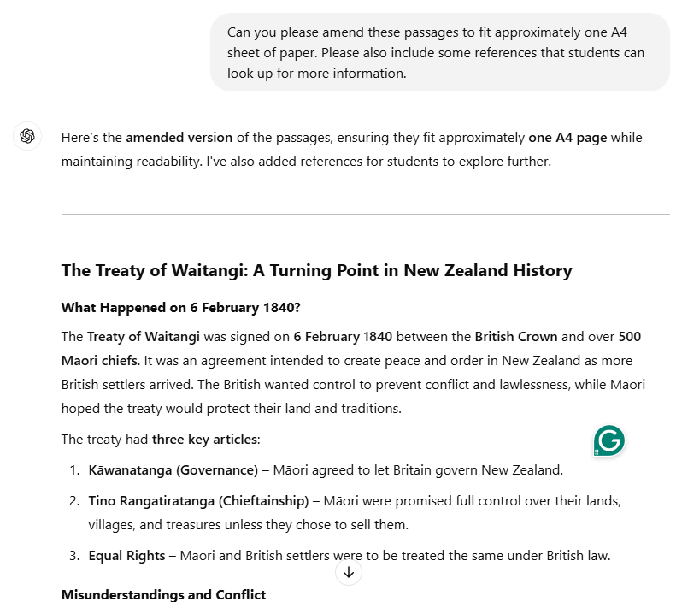
Example #2
Once you have the foundation, you can make amendments and refine the outputs.
It is up to Kaiako to check the outputs for accuracy and format the work to suit their class.

Slide 17
Key Takeaways
genAI can differentiate learning materials based on individual needs and different learning levels.
Kaiako can instruct genAI to make materials that are suitable for different abilities, learning disabilities, neurodiversity, or matched to student interest areas.
genAI can enhance student engagement by adapting the content complexity and subject matter.
This allows Kaiako to focus on deeper learning while handling routine adaptations.
Consider some of the needs in your class(es) and how genAI may be able to personalise learning.

Slide 18
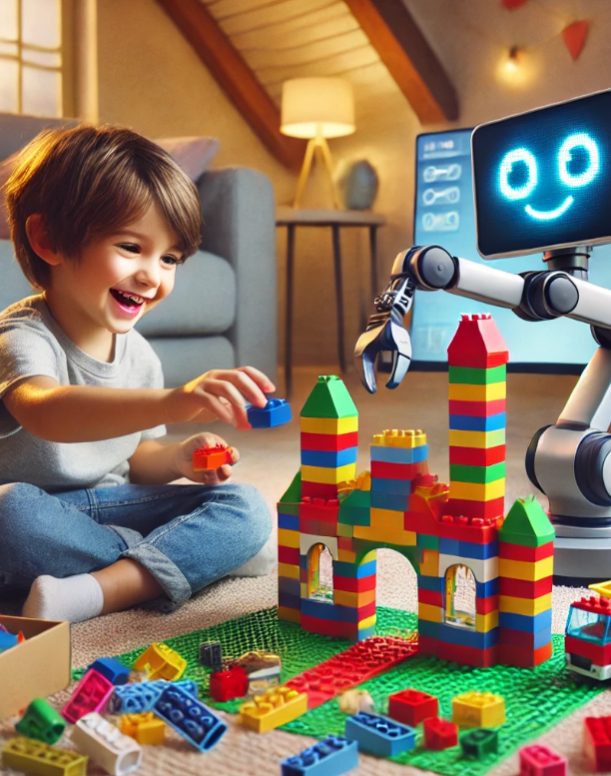
#3: genAI for Creative Learning
This was covered in an earlier presentation.
genAI can assist in creative activities, but its outputs cannot replace the creativity and inspiration of humans.
Think of genAI like a box of LEGO bricks. It is good at giving you lots of different pieces.
If you tell it “I want to build a castle”, it hands you the bricks that could become a castle and some ideas for how the castle could look. It is up to the person to put them together in their own way.
LEGO sparks creativity but it doesn’t build itself. Creativity comes from the ākonga and kaiako who take those pieces and build something from it.

Slide 19
Using genAI for Creative Learning
It is important that genAI is used as an assistive tool, rather than a replacement to make final products.
Activities using genAI can be fun and spark creativity, but it is important that genAI is used responsibly and ethically.
genAI may provide prompts, ideas, and inspiration, and in some circumstances it may produce creative works, but ākonga must acknowledge its use and refine their prompts.
Normalise having ākonga discuss how they used genAI, what ideas it gave them, and how they made the work their own.

Slide 20
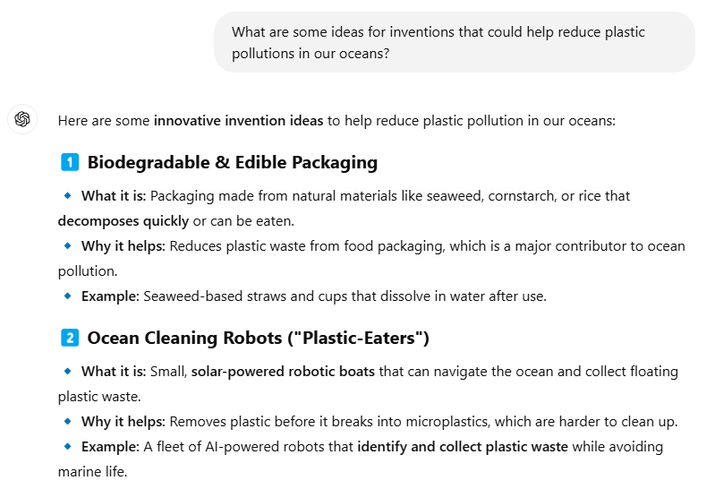
Example #3
Imagine you are teaching a class of year 7-8 ākonga and undertaking a project in technology and innovation.
Ākonga can use genAI to ask prompts, refine ideas, and test their creativity.
In this example, the project is asking ākonga to create an invention or novel solution to a problem faced in the future. For example, environmental issues, health, communication, transport etc.

Slide 21
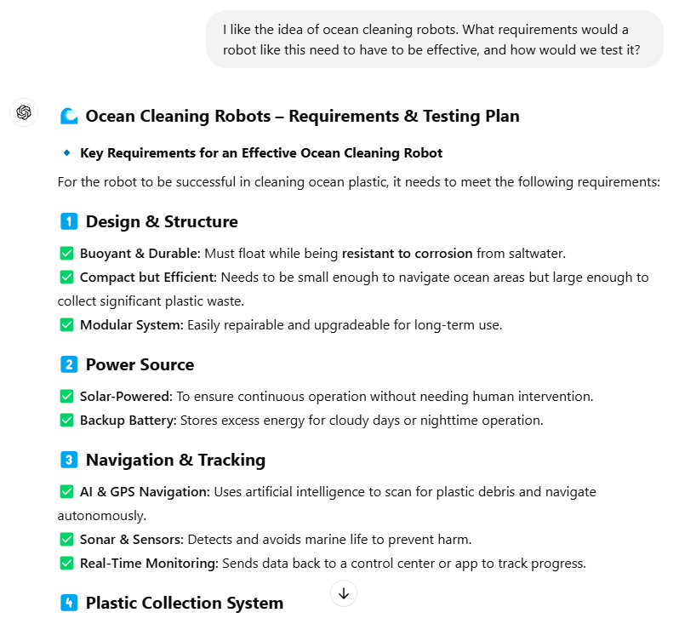
Example #2
This activity encourages ākonga to be specific with their prompts, refine their ideas, and test new ideas.
This can be a good starting point for a project that has them detail their invention, draw a prototype sketch, and share their ideas with their peers.

Slide 22
Key Takeaways
genAI can support creative pursuits, but it is important that kaiako facilitate learning that does not abuse its capabilities.
This means using genAI as a tool rather than a shortcut. It may help in brainstorming and refining ideas, but ākonga should not rely on it to do all the work for them.
Ākonga should learn to acknowledge the contributions of genAI in their work, as well as how to think critically and evaluate the outputs of genAI.
What are other creative projects that genAI could help with?

Slide 23
#4: genAI For Research and Inquiry-Based Learning
genAI can encourage ākonga to ask questions, investigate topics, analyse sources, and construct their own understanding of various topics.
It can do this through:
Helping students generate research questions and hypotheses
Providing summaries of complex topics
Providing sources for ākonga to explore further (and check facts)
Suggesting diverse perspectives on a given issue
Helping evaluate credibility and bias in sources
Encouraging critical thinking and reflection

Slide 24
Using genAI for Research and Inquiry
genAI can act as the starting point for research, not the final source.
Ākonga must verify, analyse, and interpret information independently.
Kaiako may provide a topic or subject area that they want ākonga to explore.
Ākonga can then use genAI as a tool to refine their research questions, find and analyse sources, and present their findings.

Slide 25
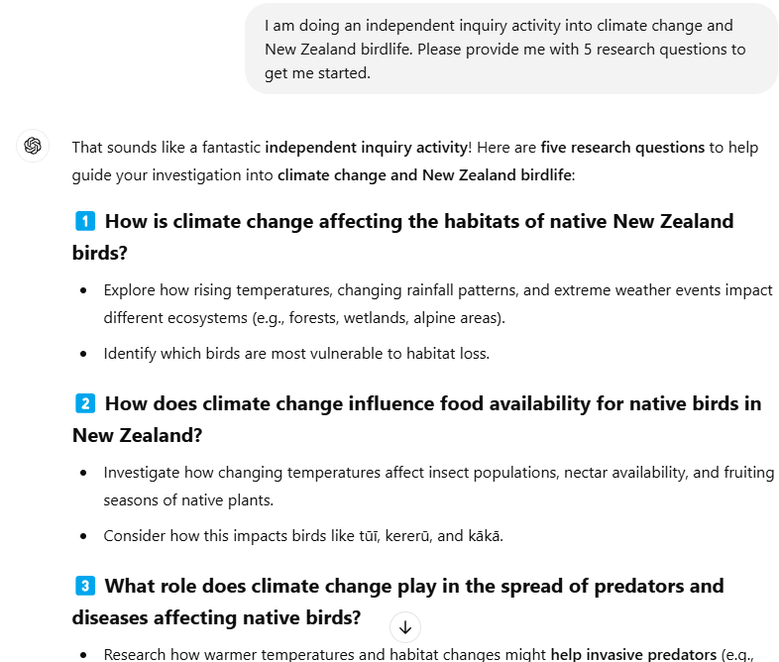
Example #4
Imagine you are teaching a Year 9 class in science, and you are undertaking an independent inquiry activity with them.
genAI may help ākonga form and refine research questions to explore further, as well as find sources to get them started.

Slide 26
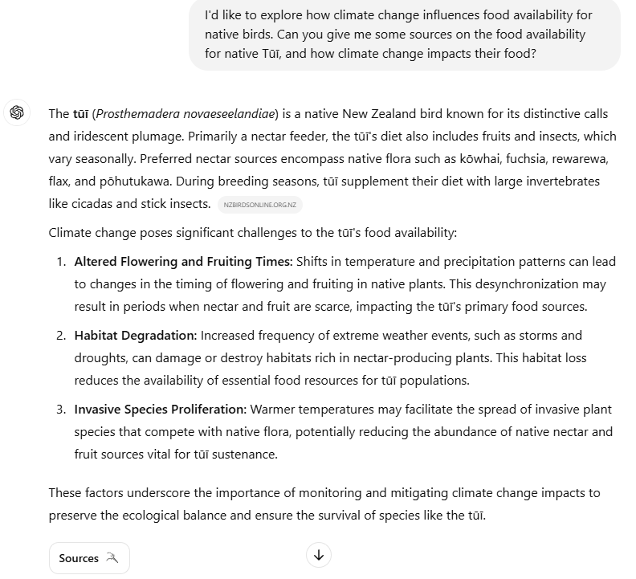
Example #4
Ākonga should verify claims made by genAI, including asking it for sources and checking these sources independently.
As part of an inquiry project, have ākonga detail how they used genAI and how they refined their ideas.

Slide 27
Key Takeaways
genAI can support ākonga to undertake complex research and inquiry-based learning activities.
It is important, though, to foster critical thinking and a scientific mindset.
genAI is a tool to support research, not replace it.
Ākonga must verify, fact-check, and cross-reference genAI outputs.
genAI can help structure research, but ākonga must critically engage with the content.
genAI should be used ethically as much as possible, including having ākonga acknowledge when it has been used.

Slide 28
genAI and Curriculum Integration: Key Points
genAI is an assistive tool: It cannot replace humans and should not be used as an immediate short-cut. Set clear expectations for how it is used.
Align genAI activities with curriculum goals: Ensure that genAI activities are purposeful, and where possible, linked to curriculum outcomes and key competencies.
genAI can assist with personalising learning: genAI is a powerful tool to help kaiako align learning activities to ākonga at different learning levels or who have different learning needs.

Slide 29
Ideas for Kaiako
Teach ākonga how genAI works, its limitations, and potential biases. This helps build critical thinking and AI literacy
Align genAI usage to specific curriculum areas and key competencies.
Use genAI to differentiate learning and personalise tasks.
Use genAI to create lesson plans and act as a teaching assistant.
Leverage genAI for inquiry-based learning activities while encouraging ākonga to have scientific mindsets.
Encourage creativity, not copying.
Use genAI to generate ideas such as story prompts, inventions, solutions to complex problems, to spark ākonga creativity.
Encourage ākonga to fact-check and verify sources to encourage critical thinking.

Slide 30
Concluding Thoughts
genAI is a tool, not a teacher. It should be used to enhance learning and engage ākonga, not replace ākonga thinking, creativity, or teacher expertise.
Critical thinking and ethical use must be prioritised. genAI content is only as useful as the questions we ask and the scrutiny we apply.
Use genAI intentionally with clear links to curriculum content and outcomes. Its role should be designed to enhance engagement and deepen ākonga understanding, not as a shortcut at the expense of learning.

Slide 31
Thank you
Thank you for coming on this journey with us.
This PLD module was last updated in January 2025.
We acknowledge that some images and content in these slides were created with assistance from OpenAI ChatGPT in 2025.
Examples given are intended to provide educators with ideas and inspiration, rather than act as an exact blueprint for learning.
For any further questions or feedback, please contact Gabrielle Wall, GCSN General Manager, at gabrielle.wall@gcsn.school.nz

